Slide 1
Feature engineering for credit card fraud
Chris Kuo, Ph.D.| Columbia University

Slide 2
Most physicians work ethically, but…
The U.S. department of health and human services in a phemphlet Avoiding Medicare Fraud and Abuse: A Roadmap for Physicians states "most physicians strive to work ethically, render high-quality medical care to their patients, and submit proper claims for payment," yet "the presence of some dishonest health care providers who exploit the health care system for illegal personal gain has created the need for laws that combat fraud and abuse and ensure appropriate quality medical care."

Slide 3

Medicare/Medicaid & private health insurance system
Medicare is a federal program that provides health coverage if you are 65 and older or have a severe disability, regardless of your income.
Medicaid is a state and federal program that provides health coverage if you qualify for a low income.
Or you can get health coverage through any of the private health insurers
The total U.S. health care spending is
18% of GDP, or
$3.3 trillion or
$10,348 per person.
$3.3 trillion * 10%
= $300 billion

Slide 4
Understand the health coding system
Diagnosis
X-ray
Ultrasound
MRI
Treatment
Physical therapy
Surgery
Injections

Slide 5
Understand the health coding system
ICD (International Classification Diseases)
Diagnosis
M75.101Unspecified rotator cuff tear or rupture of unspecified shoulder
Treatment
Drug
CPT (Current Procedural Terminology)
NDC (National Drug Code)
97001 - Physical Therapy Evaluation
97110 - Therapeutic exercises
97140 - Manual Therapy
46581-0670
Salonpas Pain Relief

Slide 6
Upcoding, unbundling
Upcoding: to “upcode” a regular diagnosis or procedure to a more serious diagnosis or procedure. Since payment is many times based upon the various degrees of diagnosis and procedures, there is an incentive to increase profits by “upcoding” procedures and diagnosis.
Upcoding example: acute bronchitis (J20.9) is reported as Simple chronic bronchitis (J41)
Diagnosis
Treatment
Drug
"Unbundling: Instead of billing for one procedure, the medical coder will “unbundle” the one procedure into multiple procedures. For example, a rotator cuff shoulder surgery is one procedure; however, that one procedure involves several separate individual procedures. A medical billing service or provider may attempt to separate the individual sub-procedures to maximize profits contrary to Medicare guidelines.

Slide 7


Level 1: One patient, one physician, multiple claims
Potential issue | Fraud detection strategy
Unbundling | Multiple services from the same provider across claims that should have been grouped.
Excessive/unnecessary services | Could be discovered when symptoms do not match diagnoses.

Slide 8
Level 2: Multiple providers, multiple claims, one patient
Potential issue | Fraud detection strategy
Unbundling | Multiple services from the same provider across claims that should have been grouped.
Excessive/unnecessary services | Could be discovered when symptoms do not match diagnoses.

Slide 9
Level 3: One provider, multiple claims, multiple patients
Potential issue | Fraud detection strategy
Phantom billing | Distribution among the patients
Excessive/unnecessary services | Could be discovered when symptoms do not match diagnoses.

Slide 10
Level 5: Multiple providers, multiple claims, multiple policies
Potential issue | Fraud detection strategy
Unbundling Phantom billing Excessive/unnecessary services Upcoding | Average cost per diagnosis, or drug # of charges per diagnosis, or drug # of visits in a week

Slide 11
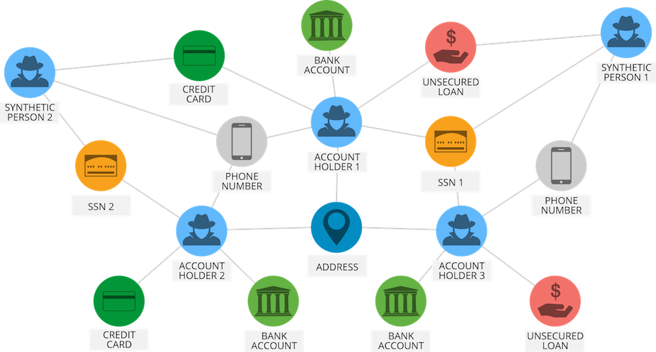
Level 6: Multiple parties, criminal conspiracies
Use graph database (such as Neo4j) to detect the fraud ring

Slide 12
Improving Fraud and Abuse Detection in General Physician Claims
Joudaki et al. (2015).
Features per physician
Standardization using Z scores
Hierarchical clustering
Determine clusters until satisfactory

Slide 13
Features for Abuse & Waste
Cluster 1 – 46%
(75 Physicians)
Cluster 2 – 54%
(89 Physicians)
Indicator | Mean | SD | Mean | SD
% of the patients that they were visited more than once in a month | 16.2 | 5.5 | 21.7 | 11.2
The average of the prescript drug items in a claim | 3.5 | 0.6 | 4.7 | 0.6
The average cost of a drug prescription claim | 23,827 | 5,398 | 29,668 | 5,662
The ratio of the 5 expensive antibiotic prescription to all claims | 0.3 | 0.1 | 0.4 | 0.2
The ratio of injection prescription to all physician claim | 0.8 | 0.3 | 1.5 | 0.4
The ratio of total injection prescription to all physician claim | 1.6 | 0.7 | 2.9 | 0.8
The ratio of total prescript antibiotic to all physician claims | 0.7 | 0.2 | 1.1 | 0.2
The ratio of injected antibiotic to physician claim | 0.2 | 0.1 | 0.4 | 0.2
The ratio of injected corticosteroid prescription to all claim | 0.3 | 0.1 | 0.5 | 0.2

Slide 14
Features for Fraud Detection
Cluster 1 – 98%
(160 Physicians)
Cluster 2 – 2%
(4 Physicians)
Fraud detection | Mean | SD | Mean | SD
% of reduplicative patients | 30.0 | 10.6 | 41.9 | 15.2
% of reduplicative patients-pharmacy | 22.9 | 10.4 | 37.6 | 18.3
% of reduplicative patients-pharmacy in a month | 5.7 | 3.2 | 10.1 | 4.9
The average cost of a drug prescription claim | 26,656 | 5,902 | 40,613 | 4,756
The ratio of claims referred to a high-cost pharmacy | 0.1 | 0.2 | 4.2 | 1.2

Slide 15
Work cited
Sparrow, M. K. (2000). License to steal: How fraud bleeds America's health care system. Boulder, Colo: Westview Press.
Sparrow M. K. Health care fraud control:understanding the challenge. Journal of insurance medicine- New York- 1996;28:86–96.
Joudaki, H., Rashidian, A., Minaei-Bidgoli, B., Mahmoodi, M., Geraili, B., Nasiri, M., & Arab, M. (2016). Improving Fraud and Abuse Detection in General Physician Claims: A Data Mining Study. International Journal of Health Policy and Management, 5(3), 165–172. http://doi.org/10.15171/ijhpm.2015.196
Aral KDGuvenir HASabuncuoglu Iet al. A prescription fraud detection model. Comput Methods Programs Biomed 2012;106:37–46.
Thornton, D., Mueller, R. M., Schoutsen, P., van Hillegersberg, J.Predicting healthcare fraud in Medicaid: a multidimensional data model and analysis techniques for fraud detection. Procedia Technology
Data

